Slide 1
What’s New with EOVSA
2017 January

Slide 2
System Update
During our visit to OVRO last week, we completed the update of the B_{x} and B_{y} baseline corrections, so that all antennas except Ant 7 (which is still down waiting for a replacement jack screw) have correct positions. We have the data for the remaining Bz corrections, but it has yet to be analyzed for the final update.
The weather was quite bad (cloudy with rain and snow) for much of the time, and will continue in that vein until next week. Under those conditions, antennas 12 and 13, which rely on solar power, do run out of power and cease to work. In fact, both are down today. Although it will be sunny today, and the systems may run during the day, it will likely take many days of sunshine to recover fully. They will shut down each night until they charge enough to survive the night. You can see the current state at:
  http://data.magnumenergy.com/MW5127/ (antenna 12)
  http://data.magnumenergy.com/MW5241/ (antenna 13)
There are some changes to the Miriad data files, which I will describe at the end, but let me first cover what we learned about the feed rotation correction.

Slide 3
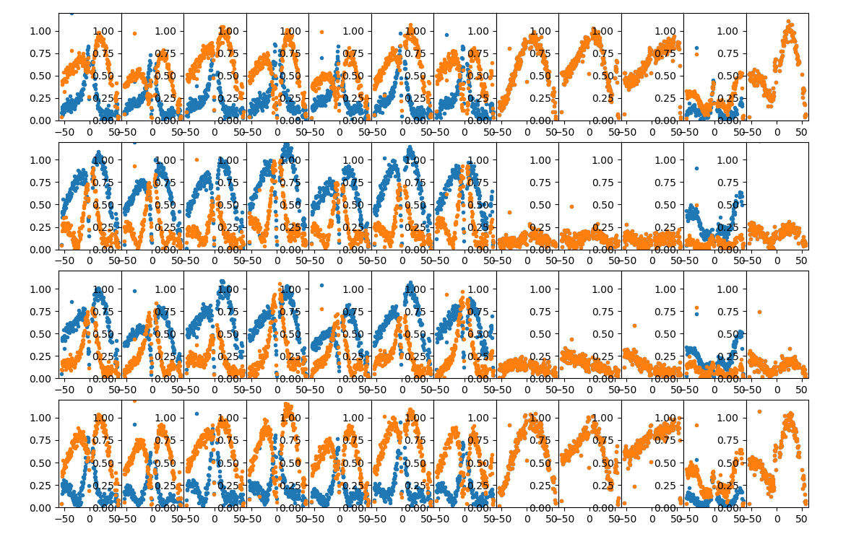
Feed Rotation Effect (amplitudes)
The main effect we want to correct is shown in this amplitude vs. HA plot:
Ant 1 2 3 4 5 6 8 9 10 11 12 13
Blue = before correction
Orange = after correction
XX
XY
YX
YY

Slide 4
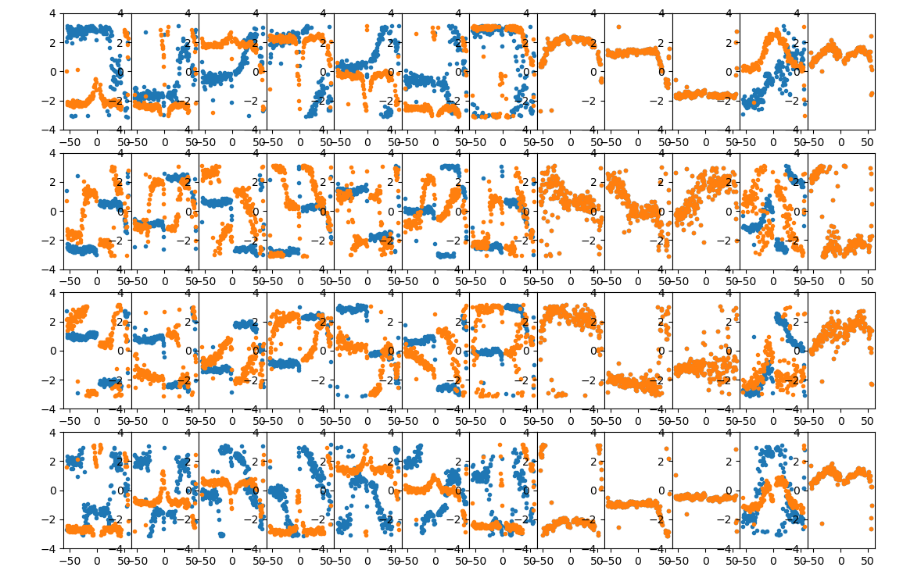
Feed Rotation Effect (phases)
One key observable is the phase relationship on XY and YX vs. XX and YY:
Ant 1 2 3 4 5 6 8 9 10 11 12 13
Blue = before correction
Orange = after correction
XX
XY
YX
YY

Slide 5
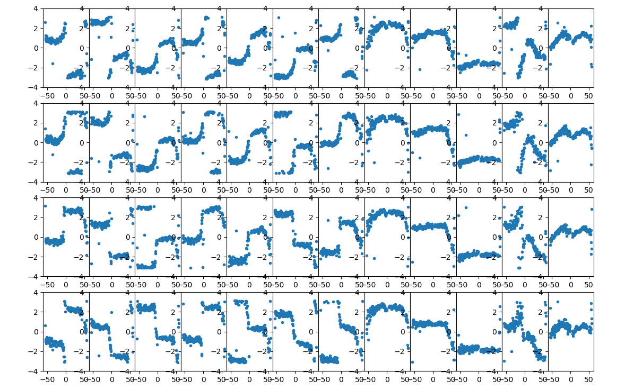
X vs. Y Phase Relationship
In particular, the phase difference, e.g. φ_{XX} – φ_{XY}, is important:
Ant 1 2 3 4 5 6 8 9 10 11 12 13
freq 1
freq 1
freq 1
freq 1

Slide 6
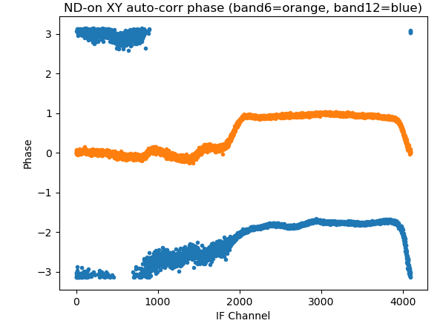
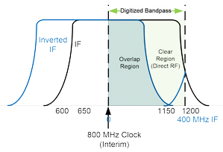
Closer Look at X vs. Y Phase Relationship
This is the auto-correlation phase φ_{XY} – φ_{Y}, on a single antennas, in one IF, for two bands, after adjusting for no phase slope (0 delay).
Overlap Clear
Region Region

Slide 7
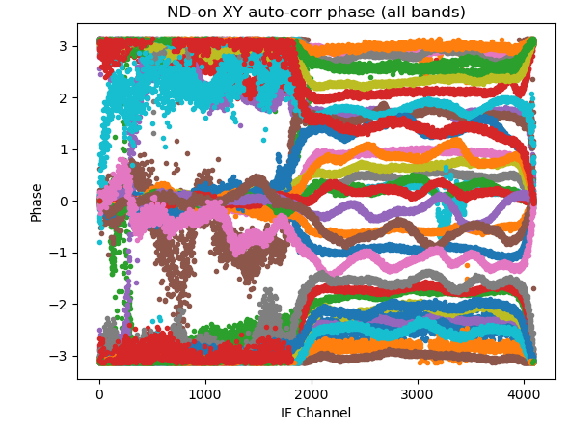
Closer Look at X vs. Y Phase Relationship
This is the auto-correlation phase φ_{XY} – φ_{Y}, on a single antennas, in one IF, for all bands, after adjusting for no phase slope (0 delay). The X-Y phase in the clear region is “interesting.”
Overlap Clear
Region Region

Slide 8
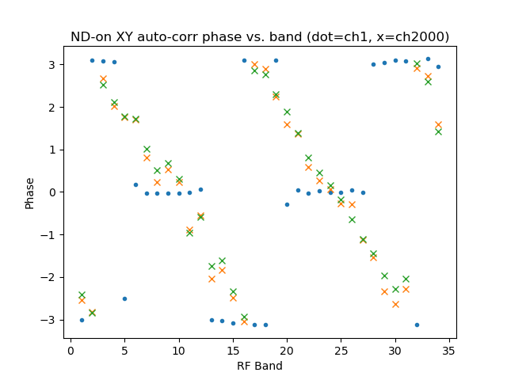
Closer Look at X vs. Y Phase Relationship
We can get a better idea of what is happening by plotting the phase vs. RF band, where we now see a progressive change in phase in the clear region, and abrupt change of phase between 0 and π in the overlap region.
φ_{clear}
φ_{over}=π
φ_{over}=0

Slide 9
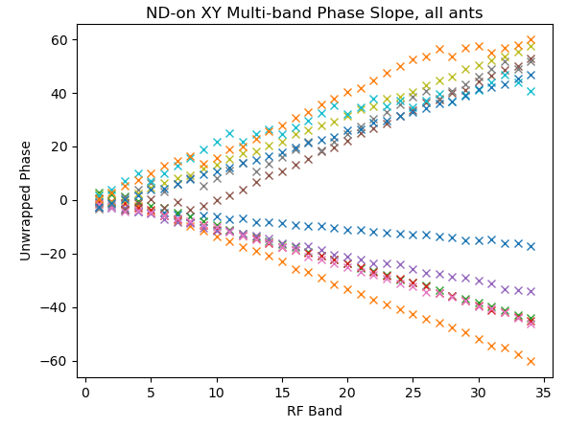
Closer Look at X vs. Y Phase Relationship
We call the delay vs. RF band a “multi-band delay.” When we plot it for different antennas, we get this result:
Antenna number | Delay (ns)
1 | -0.134
2 | -0.592
3 | -0.449
4 | -0.443
5 | -0.318
6 | +0.675
7 | N/A
8 | -0.438
9 | N/A
10 | N/A
11 | N/A
12 | +0.121
13 | N/A
14 | N/A

Slide 10
Cause of the Multi-band vs. Delay-center delays?
It seems possible that the X-Y “delay-center” delays are measuring differences in path length after the LO, while the “multi-band” delays are measuring differences before the LO.
Note that all differences measured by injecting common noise into the RF do not account for possible delays ahead of the cal source (i.e. in the feed and cables from feed to injection point).
It is possible to measure the multi-band delay on calibrator sources, which would provide the delay difference along the entire path, but this takes far more time. We’ll come back to this in the conclusions.

Slide 11
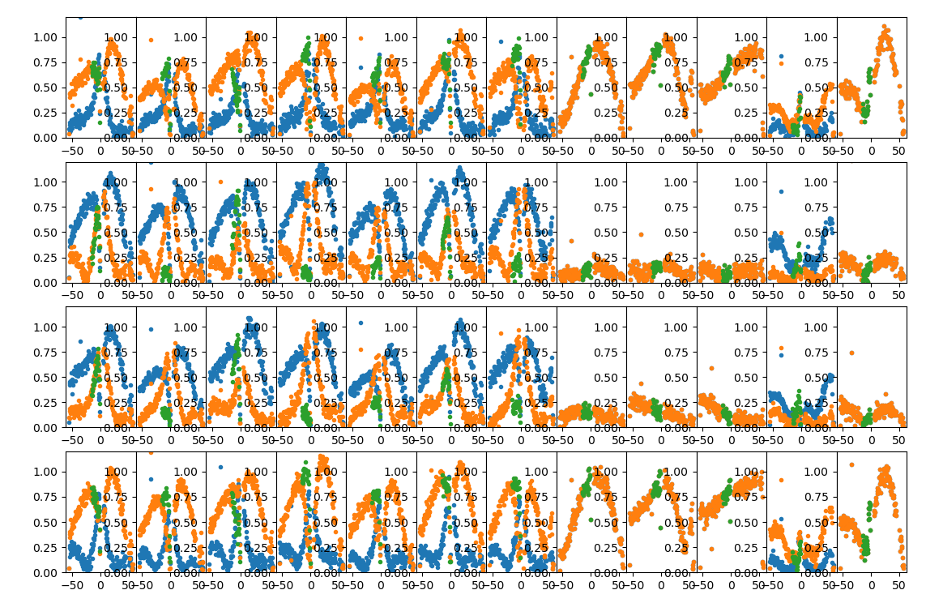
Feed Rotation Effect (phases)
One key observable is the phase relationship on XY and YX vs. XX and YY:
Ant 1 2 3 4 5 6 8 9 10 11 12 13
Blue = before correction
Orange = after correction, no multi-band delay
Green = after correction, with “nominal”
multi-band delay
(for 1 h only)
XX
XY
YX
YY

Slide 12
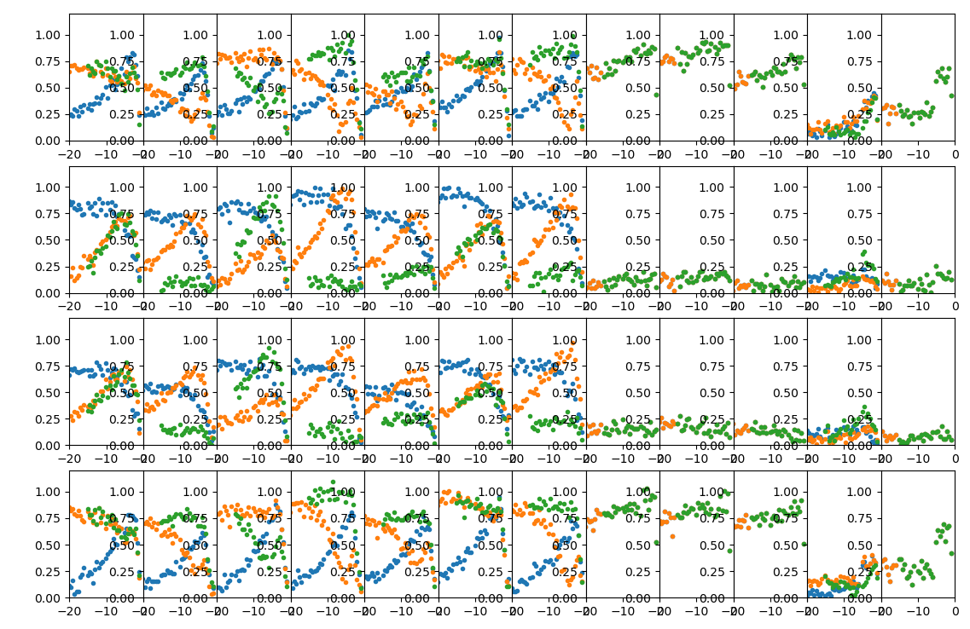
Feed Rotation Effect (phases)
One key observable is the phase relationship on XY and YX vs. XX and YY:
Ant 1 2 3 4 5 6 8 9 10 11 12 13
Blue = before correction
Orange = after correction, no multi-band delay
Green = after correction, with “nominal”
multi-band delay
(for 1 h only)
XX
XY
YX
YY

Slide 13
Comments and Conclusion
I think we now have an excellent understanding of the feed rotation correction, and can do it well, when the X-Y delay is known.
We have two ways of measuring the multi-band delay (fast, using noise cal source, or slow, using calibrator observations), and it shows some potential for giving the right X-Y delay in order to do the correction.
We have not yet attempted to correct existing data for the measured multi-band delay, but will do so as soon as we can get to it.
We still worry that a stable correction will require detailed knowledge of the delay which:
  May change slightly over frequencies within a band.
  May change with time (we plan to do some repeated observations to check this).
If it is stable and well-behaved, we can apply it to earlier data as well as future data.

Slide 14
Tohban Update
The solar observations should be continued as normal. However, Ant 14 requires close monitoring, so please log on at the times just prior to calibrator source changes and make sure that it does the source change (unless a windscram prevents it). If it has a permit error (on either axis, but Dec is the one that usually has a problem), just do
    reboot 1 ant14 (wait for reboot to complete)
    tracktable pcal_tab.radec ant14
    track ant14
Changes to Miriad files:
  The IDB files are now written for only the frequencies in the sequence, hence are much smaller, and file reading should also be faster.
  The UDB files now average in time instead of frequency, hence they have all frequencies, but at 1 min (60 s) time sampling.

